Slide 1

Supercharged
Serverless
Notes:
Hello my names Josh, I work as a Developer at CloudCall and primarily hack away at our IM/SMS systems. Which is heavily powered by Serverless functions. We’ve learnt a lot since we started developing serverless architectures and that’s what I’m going to talk with you about today.

Slide 2
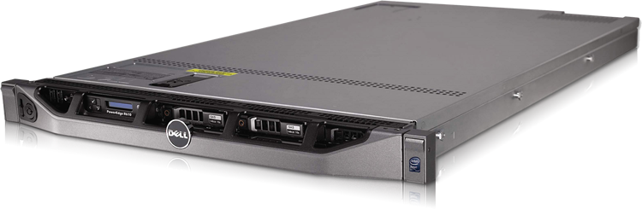
What about me?
Notes:
First we need to briefly discuss what this technology is… So Server-less. Server-less. What does that imply? - ASK AUDIENCE
Yes that’s right, there is no server! Is it the end to this lovely little 1U over here? Well let’s find out

Slide 3

Notes:
Well yes, but actually no. It means you’ll no longer need to own or even rent dedicated hardware. Instead it implies the following...

Slide 4
Billed only for
what you use, scaled on-demand,
load balanced automatically,
no maintenance
Notes:
READ board - pretty great right?
So let’s break this down
Billed only for what you use - let’s say you have a CRUD API responsible for user settings. Instead of hosting that on a dedicated box that is always spinning and listening for requests, we are only billed when the function is actually called. If the users are not updating their settings - then we aren’t billed and we waste less money on server costs.
Scaled on demand - instead of cloud hosting like ECS or VM’s responding to CPU and memory usage stats to scale to new instances (which is slow as hell). Serverless scales per execution. This means that if a request is being processed by a lambda instance, then another one will start up to process the next one.

Slide 5
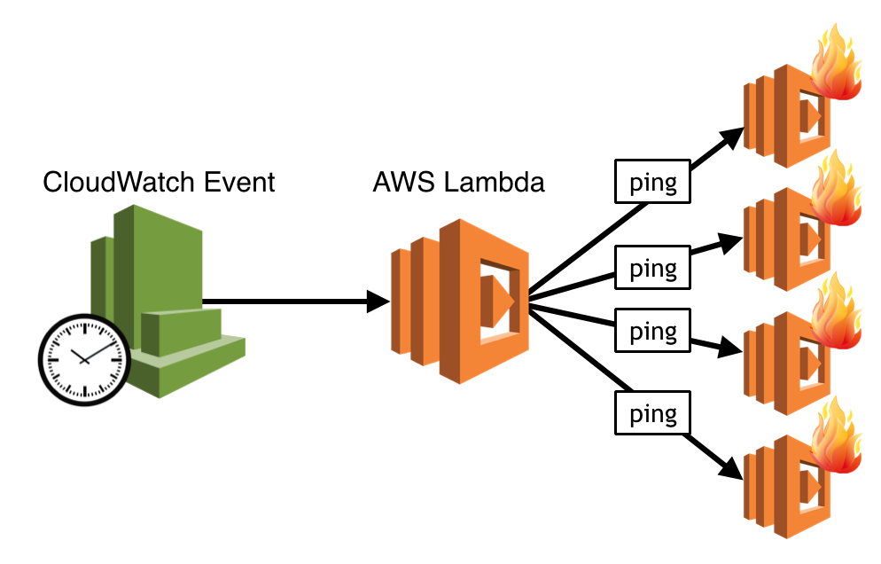
Lambda
Scaling
Notes:
Connected with that is the load balancing, normally you would need ELB or some other type of load balancer in front of your physical servers to distribute load evenly across instances. But with serverless, the API gateway will simply send those requests to an instance that is free or spin up a new one to process the request. We have this flexibility because although it is starting your entire app the runtime is incredibly slim.

Slide 6
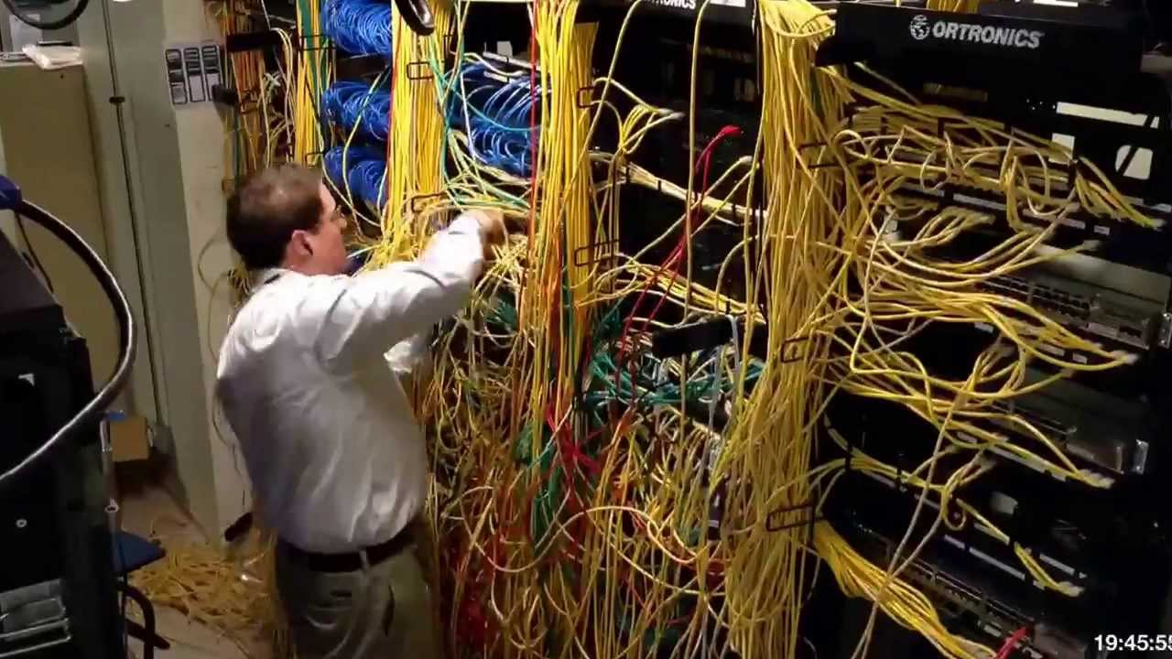
Notes:
No maintenance - if you have physical servers you have to manage or even VPS’ then doubtless you will have had to upgrade packages, and operating systems and even the hardware itself. Again, serverless removes all these problems, because it’s a docker container we can guarantee a consistent environment across deployments and all maintenance is handled by the cloud provider.

Slide 7

Hearing Programmers talk about “revolutionary” technology
Notes:
Now if you’re hearing this for the first time, you might be a little skeptical of this. Sounds a bit too good to be true. What’s the catch? Well obviously, like everything there is trade-offs - which we will cover later. But serverless is truly a groundbreaking technology and will shape the future of technical architecture

Slide 8
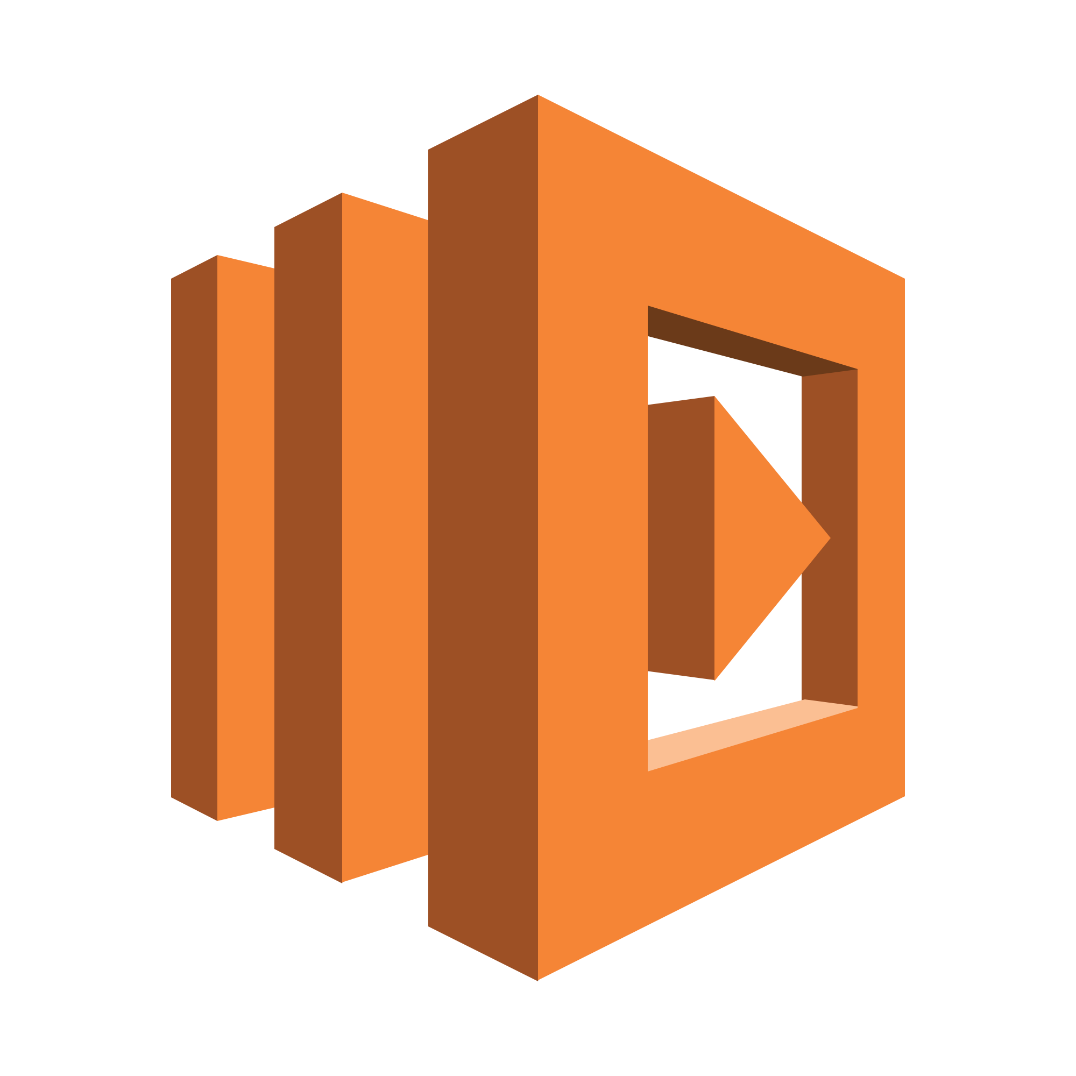


Serverless comes in all shapes and sizes
AWS
Azure
GCP
Runtimes:
NodeJS, Python, Ruby, Go, Java, .NET (C#, F#)
Runtimes:
C#, JavaScript, F#, Java, Python
Runtimes:
Go, Python, NodeJS
Notes:
Many different Cloud providers offer a what is called “Functions as a service”. There is Amazon with Lambda, Azure with “Functions” and Google with Cloud Functions. They are all great, but personally, Lambda is miles ahead of the others for a number of reasons - primarily the runtimes offered, and it’s cheaper and faster than the rest.

Slide 9


Notes:
Ok but what is Lambda under the hood? It’s important to find out because we need to know the internals before we can go about understanding how to optimize it. Lambda is just a simple docker container hosted in ECS (which is basically EC2 with a container management on top) - that’s it! Simple right.

Slide 10
How does it all work?
Notes:
How else does Lambda work though? - these rules apply to most serverless compute services
If Lambdas fail, by let’s say a throw new Error then...

Slide 11
Lambda’s Failing
Fail!
Nope!
Yay!
Notes:
They fail and then AWS automatically retries them up to 3 times. This is also the behaviour if you do a “context.fail” where the context is the fail is the “runtime” of the lambda.
If you’ve got a Lambda triggered from a queue, then Lambda is smart enough to DLX the message for you too

Slide 12

15
minute
execution window
Notes:
Lambdas have a maximum request time of 15 minutes. This means the longest process a Lambda can run is 5 minutes - so if you are needing to do an API call to get some data that takes 10 minutes - you’re outta luck

Slide 13
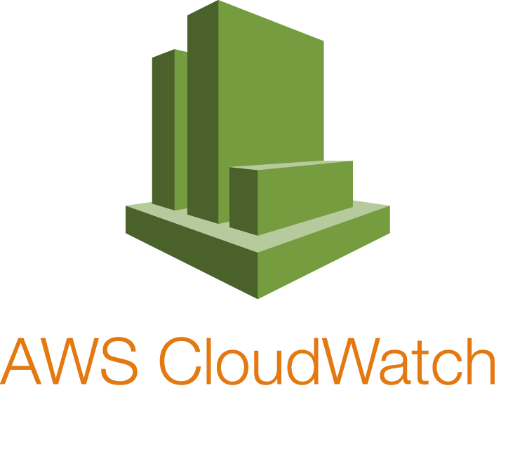



All aboard the event bus!
(context, event)
Notes:
Lambda’s are triggered via an event bus. This event bus can be pushed to via SQS, Cloudwatch or most commonly API Gateway. This event bus provides a translation layer between the Lambda and the callee.
Digging into this event triggering a bit more, let’s discuss how a Lambda would be triggered via HTTP
Now you might think it’s as simple as calling the lambda and bobs your uncle.
But Lambda’s are always triggered, they don’t handle anything themselves. In the case of a HTTP call, they are triggered by API Gateway that is in front of the lambda
That passes the “context” and “event” to the Lambda which then handles and passes back the output.
It’s a bit of a weird thinking pattern but it opens up a whole world of possibilities of what you can do with Lambda - which we will cover later.
So what can Lambda do?

Slide 14

Notes:
Well probably not your bitcoin mining operation

Slide 15
Serverless Can Do Anything
Listen to SQS messages
Cron Jobs
Websockets
DynamoDB updates
S3 Uploads
Emails
HTTP API’s
Kinesis streams
Notes:
But pretty much anything else! Serverless is more than just Functions-as-a-service.
Lambdas can be setup to trigger via SQS messages (which is just an aws branded queue service),
CloudWatch CRON (which is AWS cron jobs essentially)
Even websocket messages can trigger lambdas
Obviously they can also be triggered via HTTP - in the case of API’s

Slide 16





When to use Serverless
When a service doesn’t need to be always running
To cut cost
For splitting up a monolith
For distributed teams
In a multi-language team
Notes:
Microservice type architecture has exploded in recent years and it’s inpart because of serverless technology.
Think about your personal project or company’s product. Is there a service you can think of that doesn’t always need to be running?
At CloudCall, when architecting our IM/SMS products chose to put our inbound and outbound webhooks in Lambda - these are the API’s that are called whenever a message get’s sent on our service. This might seem short sighted - after all, aren’t people always going to be always sending messages? - well no is the answer. Outside of business hours, our application is seldom used. And despite going global, CloudCall will not always have people sending messages, they might be placing calls or doing a myriad other things. In any case, it’s not worth keeping those services spun up all the time waiting for messages, when there might be a minute or two between requests. Plus serverless is so cheap, that it’s unlikely we would ever get to scale where a long-lived instance would work out cheaper.
Serverless architecture is also something to consider when you are attempting to break down a buggy monolith. Lambda provides you a way to deploy services in a more modular fashion. But be careful to not just create a distributed monolith!
Further, if you have a team proficient in multiple programming languages then it means you can create API’s and services in whatever language that team knows or feels suites the job.
For example, at CloudCall we use a mix of .NET Core and NodeJS for our backend. We have used .NET for more beefy processing and then we generally use Node for API’s. However, one team just a couple weeks ago wrote an API in the language that they knew best, which was .NET. And that’s perfectly fine with this kind of architecture.

Slide 17





When shouldn’t we use Serverless?
CPU Intensive tasks
When you need File System storage
You don’t have years to write CloudFormation templates
Where latency is critical - financial transactions, voice, search
When you want to avoid heavy vendor lock-in
Notes:
But when shouldn’t we use serverless?
There are situations like financial transactions, voice and searching where millisecond latency is critical. Serverless would probably not fit the bill here because you’d want to shave off any latency possible - including boot up times etc.
CPU intensive tasks - if you are doing large scale video transcoding, again serverless is not great for this. Not only because it’s got a tiny amount of temporary storage but also because the CPU resources would not be up to the task.
As I just mentioned, AWS Lambda’s have extremely tight file system allocations, they are given just 512MB so anything more than that and you will need to either utilize S3 or just use a long-lived application
If you’re a bit Edward snowden about things, then you perhaps want to avoid vendor lock in. If this is the case, there is basically no way to spin up your own local version of serverless. There are a few tools but the cost and time to develop infrastructure like that would really not make sense.
Following along from all that configuration, serverless does take a lot of time to configure. Although tools are coming along leaps and bounds, writing cloudformation templates or terraform scripts takes a lot of time and it’s a new tool to learn! It’s not as simple as just booting a docker container.

Slide 18

How?
Notes:
But let’s say you do want to use serverless! How can we port an existing express application to AWS Lambda?

Slide 19
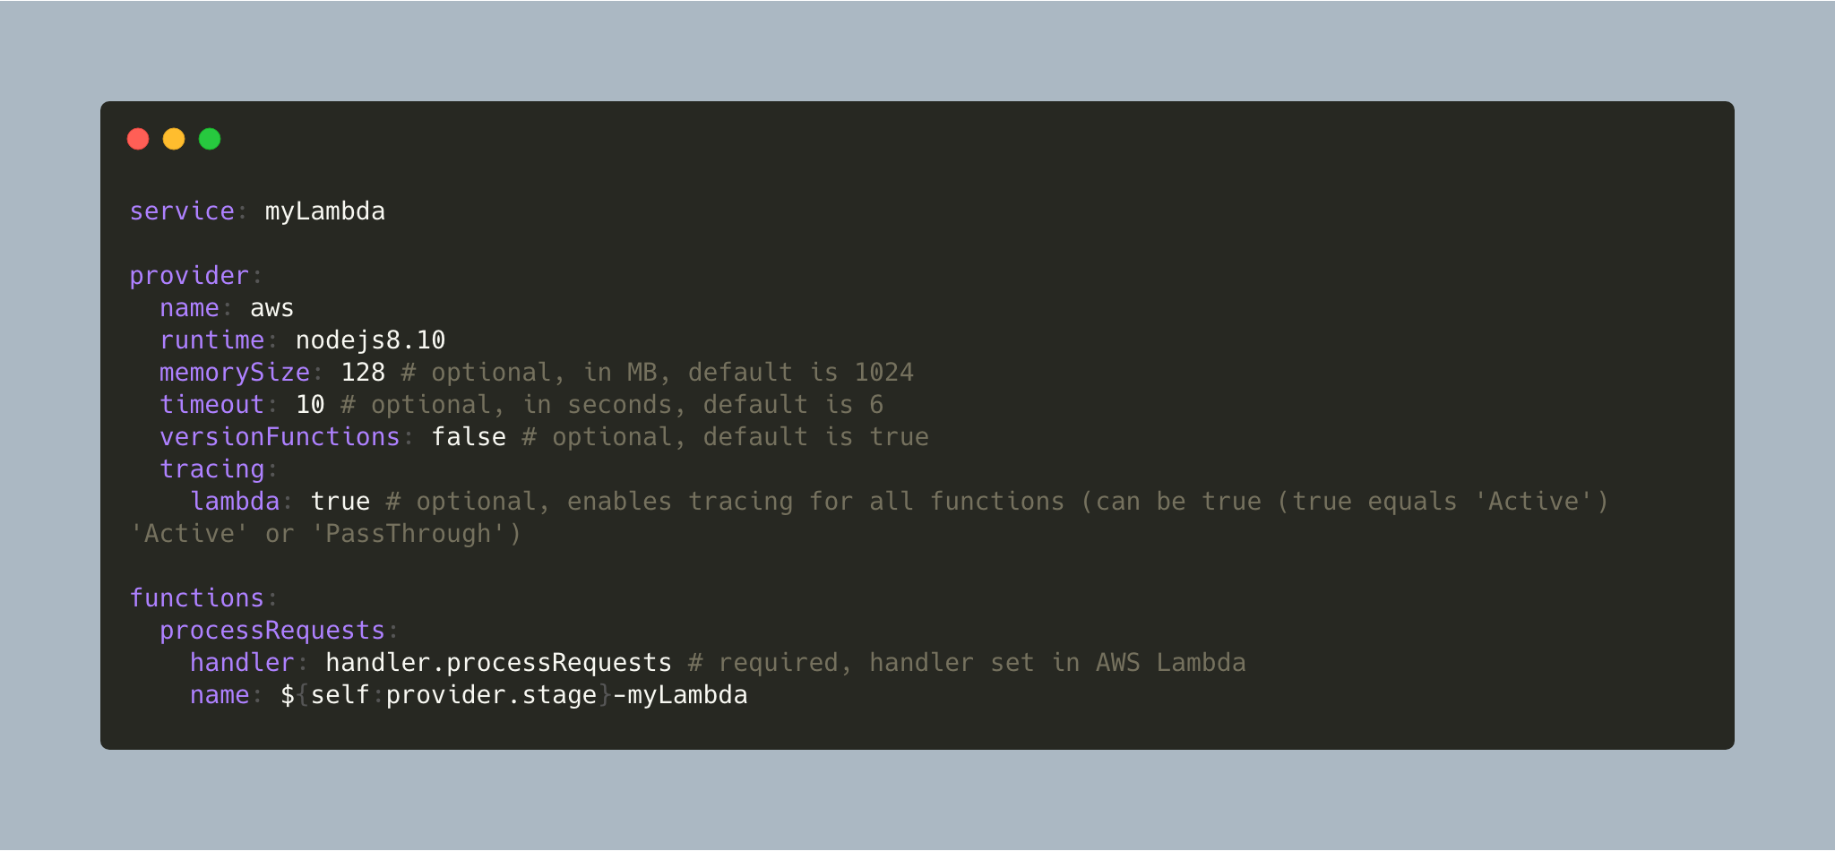
serverless.yml
Notes:
Using the serverless framework, here is all you need to configure a brand new NodeJS Lambda
Run through the different parameters
Now note the “handler” field, what does that mean?

Slide 20
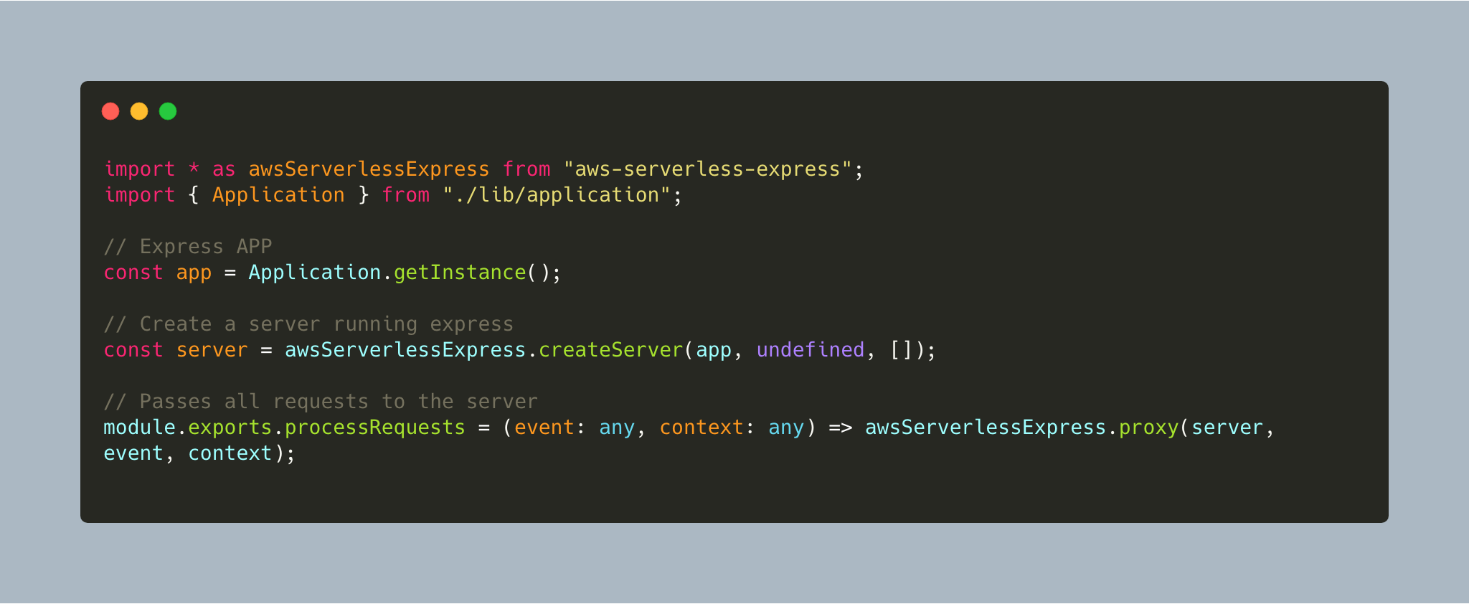
handler.js
https://github.com/cloudcalldev/crud-boilerplate
Notes:
Just pop this code and now you have an aws serverless application!
But how does this work?
Well first of all in our serverless config we defined a function and set the handler to be
Handler.processRequests
The first part of that refers to the file so if you had the file called hello then the handler would be set to “hello.processRequests”
The second key part of this file is the last line
After the dot in handler name, after the file name, we added “processRequests”, this is the function that we want the Lambda to call within that file
We have this file along with a complete boilerplate for usage with AWS Lambda in the repo listed there. This is under active development by myself so there is a lot missing like health checks, DynamoDB, tests etc. but it should at least get you started with a basic AWS Lambda backed by express.

Slide 21
What else?
Port code using the Filesystem to use S3 Buckets or similar
Bundle or remove native packages
Configure a VPC for firewalled services
Remove ptrace and system calls
Remove any port 25 TCP calls (used for SMTP)
Notes:
So what else do we need to do?
Well as mentioned before, Lambdas have a limited filesystem, so if you are using anything that writes to the filesystem then you will need to port that code to use something like S3 instead.
Because Lambda just runs the code you ship it, if you want to use native packages then you will need to either get rid of them or use Docker to first build the package and then ship a zip file to the Lambda. Obviously, including native packages increases your bundlesize which contributes to your Lambda storage limit.
Finally, if you have an external database that has a firewall (which it should do), then you will need to create a VPC (Virtual private cloud) to allow the Lambda to communicate with. This has the effect of slowing the lambda down - which we will cover later. Alternatively, if you are creating a new service, take a look into DynamoDB as it’s a great document DB which powers a lot of the Lambda’s here. New databases are good as well as they mean they force you to take a decoupled approach to your microservices.
Couple of minor points are that you cannot use ptrace and other system calls and TCP traffic over port 25 is blocked. I think so people can’t start their own on-demand mail servers using Lambda - although they say anti-spam

Slide 22

Notes:
Now we’ve done the figuration, how do we deploy it?
Serverless deploy
That’s it. Simple as that! Now obviously you have to have setup AWS locally and if you are running in production, I probably wouldn’t recommend this but it’s a great way to deploy serverless if you just want to get on with it.

Slide 23
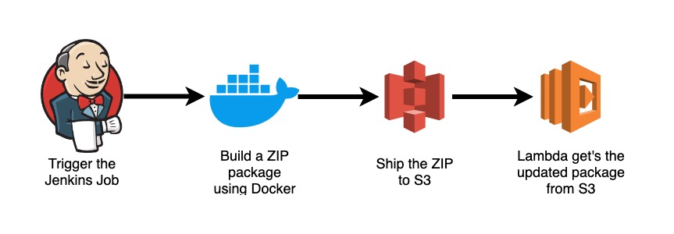
Deploy!
Notes:
A more sane deployment strategy would be to have a continuous integration service build the image using Docker, then ship the resulting ZIP file to s3. Then update the Lambda with the new code from S3.
The advantage of this is that you can trace who deployed the service, when and with what code. Furthermore, using Docker means that you get a consistent build environment. And as stated before, if you want to use native packages then you’re going to have to build with something like docker

Slide 24
Pay per millisecond of execution
Notes:
In serverless, rather than paying by per hour, we pay for the amount of milliseconds each execution takes.

Slide 25

Notes:
But don’t panic! Let’s discuss how we can improve the performance of our serverless functions

Slide 26
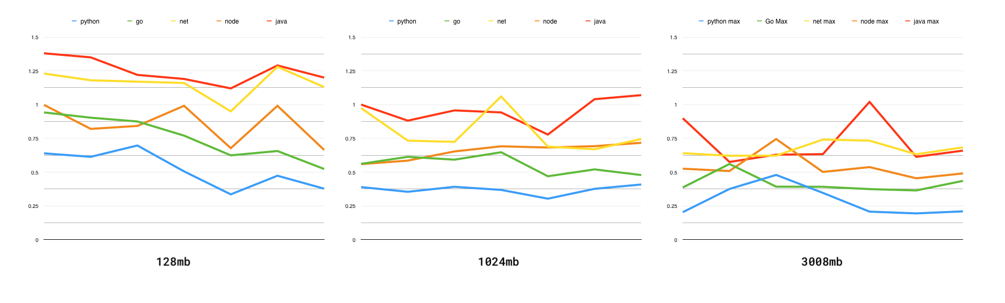
TL;DR Don’t use .NET
Notes:
TL;DR Don’t use .NET also don’t use Java
But seriously, it’s probably best not to use them. Although they’ve come along leaps and bounds and the .NET core 2.1 runtime is getting better by the day, it still suffers from bad cold start times and general slowness. This is not a fault of .NET core because that’s great, but in the serverless world you’re much better off using Node or Python.

Slide 27


Reduce Startup Dependencies
This is not just dependencies (or bundlesize)
Focus on having only the bare essentials to start your app
For example if you have a CRUD API, you don’t need to connect to the database first as the request may fail - it gets terminated, validation fails etc.
YOUR APP
Notes:
Now you may have heard that reducing dependencies is a good thing for web development. Load less stuff and it goes faster right? The same principle applies here: load less stuff to start up the app, and you will have your app start faster which means the cold starts won’t be so much an issue.
Now it’s worth noting that this does not mean node module dependencies. It purely means the amount of stuff we are doing or loading before the app actually begins serving requests.
For example, let’s say you have an app that updates a database. Does it need to connect to the database as soon as it boots? In a long-lived application, you might do this so you can ensure application health. But in the case of serverless, it is not needed.
It could be that the request to update the record was invalid or a validation error caught something and it doesn’t use the database connection. So try to really par down the things you are booting with, this will be particularly important as you scale.

Slide 28

Silent but Deadly
AWS Lambda allows you to scale Memory allowance
Scaling memory also scales the CPU resources
Performance scales at least proportionally to the memory allowance*
256MB RAM
YOUR APP
Notes:
Lambda’s all start out with 128MB of RAM. You can increase it all the way to 3008MB. But why would you ever want to do this? After all, 128MB is more than enough for a basic express application!
Well turns out, as you scale the memory allocation, it also scales the CPU. This means that the application will start and run faster. Now although it is more expensive to use more memory, the speed gains you get from this will be proportional to the cost - it also means customers are waiting less time for API responses so it’s worth it from that perspective too.
Scaling this RAM and therefore CPU is one of the biggest things you can do for quick performance gains on your app. However, this scaling is not a linear curve, if you ramp up your Lambda to 3008MB then you might feel like you could launch a rocket but at a certain level the gains begin to plateu. Which is where this atrisks comes in...

Slide 29
* More memory doesn’t always mean it will go faster.
Notes:
So the minor footnote is that more memory doesn’t mean more speed always. Lambda’s might be spun up on machines that are saturated already so it might not run quicker than another with less memory. We spoke earlier about how Lambda is just ECS under the hood so when Amazon goes to spin your Lambda, it may only find ECS boxes that are being used heavily. Although the “completely fair scheduler”, or whatever tool they use for task scheduling should do its job, it’s not always perfect, and there could be factors like thermal throttling of the CPU or something else which would cause the memory allocation to not correlate to a faster run time. Therefore Generally speaking the higher the memory, the faster it is, but this is not a linear curve

Slide 30



Notes:
Now as mentioned before, if we increase the ram, then the higher the cost, but also the faster the execution time. So how can we figure out the best “bang for your buck” balance of performance and cost
Although increasing memory will make your lambda run faster, it costs more to run it with higher memory!
So choosing the right amount of memory for your application is import because you don’t want to be burning cash! But how?golang vs nodejs lambda

Slide 31
CloudWatch Reports
Notes:
The best way to find out how much memory your Lambda needs is to of course test it!
Check the CloudWatch logs for your Lambda and you’ll always see something like this at the end of the request. If the request ran out of memory or it was close to maxing out the memory. Then scale it up. Keep going until you reach a happy medium

Slide 32
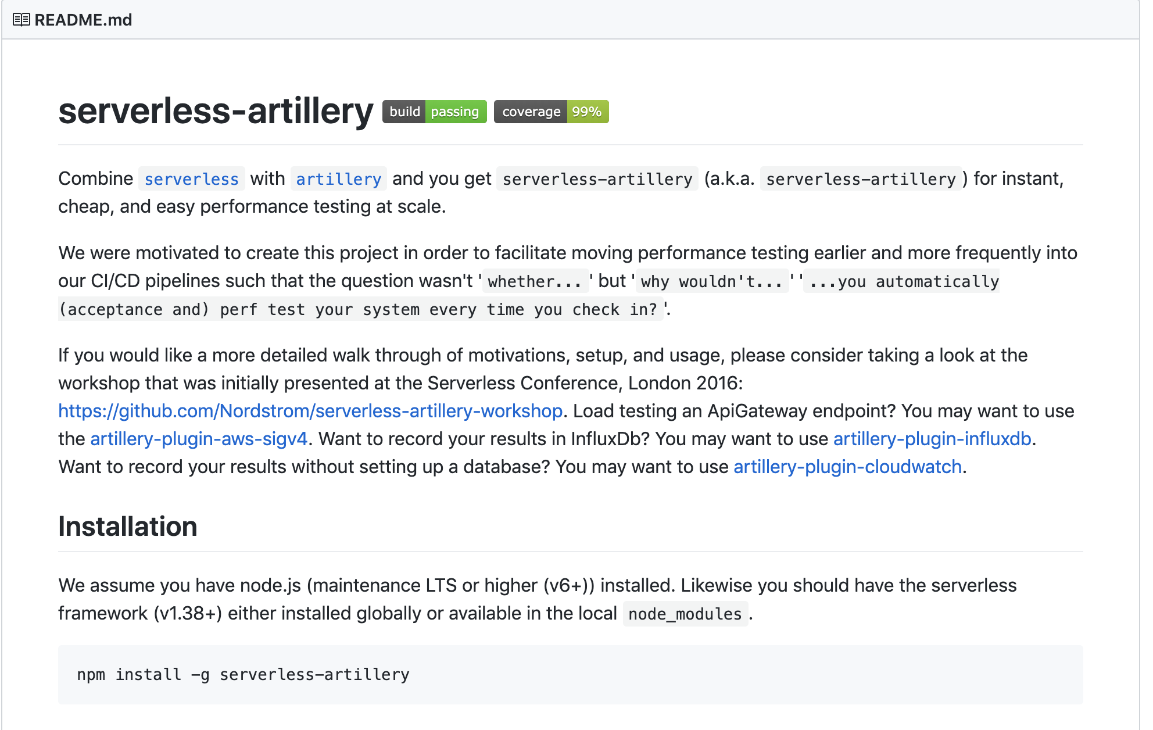
Load Testing
Notes:
Next is to load test the lambda, this will help you establish how long your function takes to run on average when under load.
This is a true metric of how your lambda will perform. It’s important to load test using the kind of load you are expecting to handle + 10% or so, to allow for room to grow.
Load testing could be a talk within itself but is very useful in identifying issues at scale. Previously we have spotted that one of our webhooks, although it was responding with 300ms or less, when hammering it with 1000 requests a second, it began to very quickly grind to a halt. So we scheduled time to optimize this. Previously we would not have known about this until we reached that scale.

Slide 33
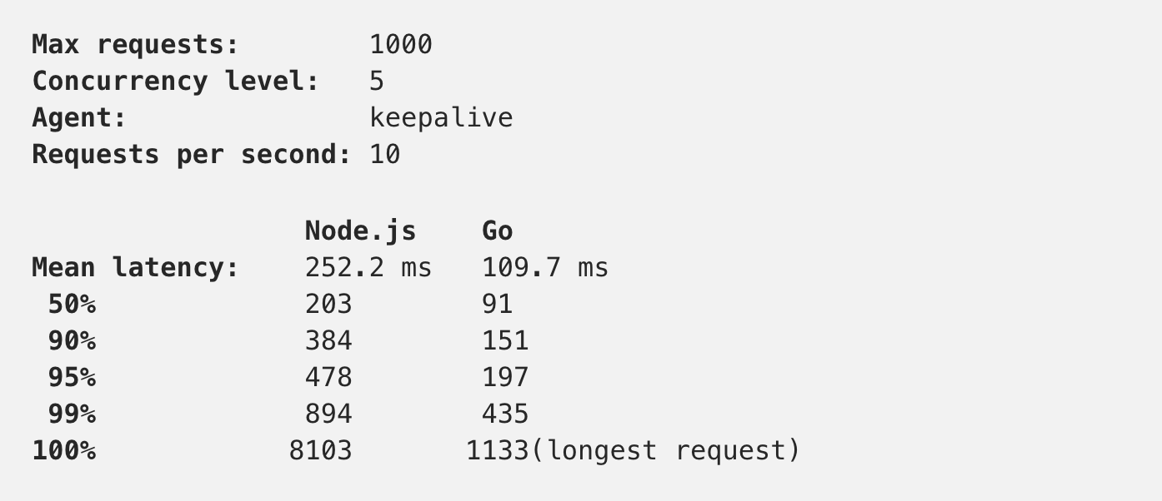
Consider the task
Notes:
If you are working on a lambda that is responsible for image transcoding the something like Golang or Python is going to be more suited to than NodeJS
The above results are taken from a test comparing Golang and NodeJS when downloading a 50KB image from S3 and then update a record in DynamoDB.
Now for whatever reason, whether due to runtime optimization or whatever else, Golang was up to 40% faster. This difference would be even more evident with more CPU heavy tasks so it’s worth considering what the lambda is actually doing before choosing the language.
Of course anything can be done in any language, just some are more suited than others to particular tasks.

Slide 34
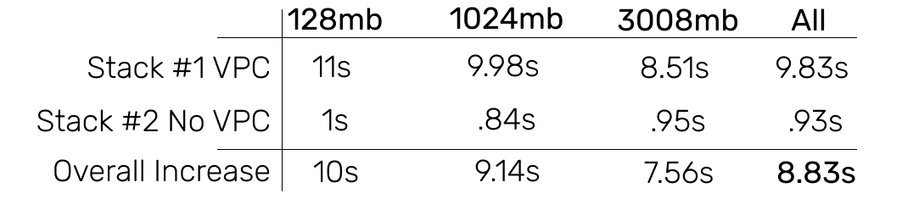
VPC Latency
Notes:
So now onto the biggest factor in cold start latency - VPC’s.
VPC’s stand for Virtual Private Cloud and are an Amazon service that allows you to create a AWS services within a virtual network similar to how you would deploy applications to a data center you might own. You don’t always need it AWS to AWS service communication but can be used if you want to make your AWS service more secure. We use it for not only the security but also so we can access applications we have deployed in our datacenters - RabbitMQ, our windows services and Database - which would be too costly to put into AWS.
You can see from the table above that was measuring a like for like comparison between a lambda within a VPC and without a VPC. Although this seems bad, remember these numbers are only for the lambda cold starting. A massive increase!

Slide 35
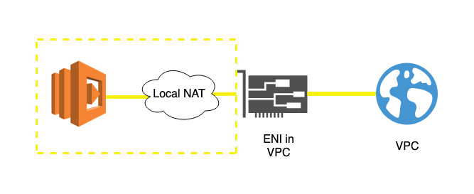
Lambda’s with a VPC - Now
Notes:
This is how the current architecture of a lambda behind a VPC looks currently. A new ENI has to be created and assigned to your lamba each time it boots - hence the horrendous cold start times. This is not only bad for the slow start up time but also because the rate at which you scale cannot exceed your ENI limit. Basically it means you could run out of IP addresses and be unable to start a lambda. So what’s the solution?

Slide 36
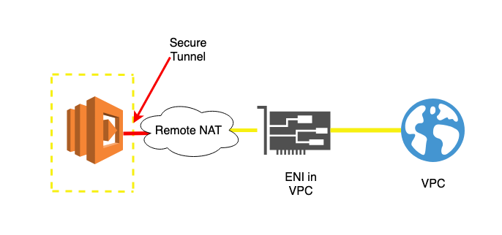
Lambda’s with a VPC - Coming Soon
Notes:
Luckily, amazon had heard the shouts from all the cold lambdas and decided to rearchitect how Lambda works.
There is a whole talk on this at Re:Invent 2018 called Lambda under the hood which I highly recommend watching but to distill this new architecture down, essentially what will happen is instead of creating a new ENI for each new lambda, it will be reused. This will have the effect of making all functions within a VPC have the same IP address.
This is still very much work in progress however

Slide 37
Do you need a VPC?
Put in subnet with NAT’d route to internet
Does my function need access to any resources within the VPC?
Does it also need access to resources on the public internet?
Don’t put in a VPC
Put the function in a private subnet
Notes:
Although there are improvements coming, generally speaking, even after this new architecture comes out, you should be cautious about putting your Lambdas in a VPC.

Slide 38

Cold starts? What’s the big deal?
Notes:
Cold starts are something that I’ve mentioned a lot in this talk because it’s the one thing people fear with serverless technology.
But why did it gain such notoriety? Formally AWS used to “freeze” a function after 5 minutes of inactivity. But since then, they have slowly increased it. To the point now where functions will usually stay around for about 45 minutes before freezing. Unfortunately, there is no documented value for how long aws functions stay around but a lot of tests have been done and the word on the street is that is approx 45 minutes.
Nonetheless, as you scale you will suffer the cold start problem, but you would just the same as if you were scaling an ECS instance.

Slide 39
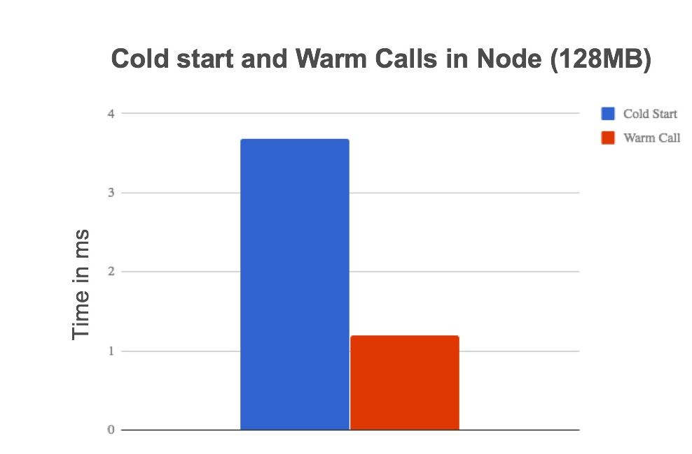
source: blog.octo.com/en/cold-start-warm-start-with-aws-lambda/
Notes:
But what effect does cold start have on your app?
Well looking at this graph, massive is the effect.

Slide 40
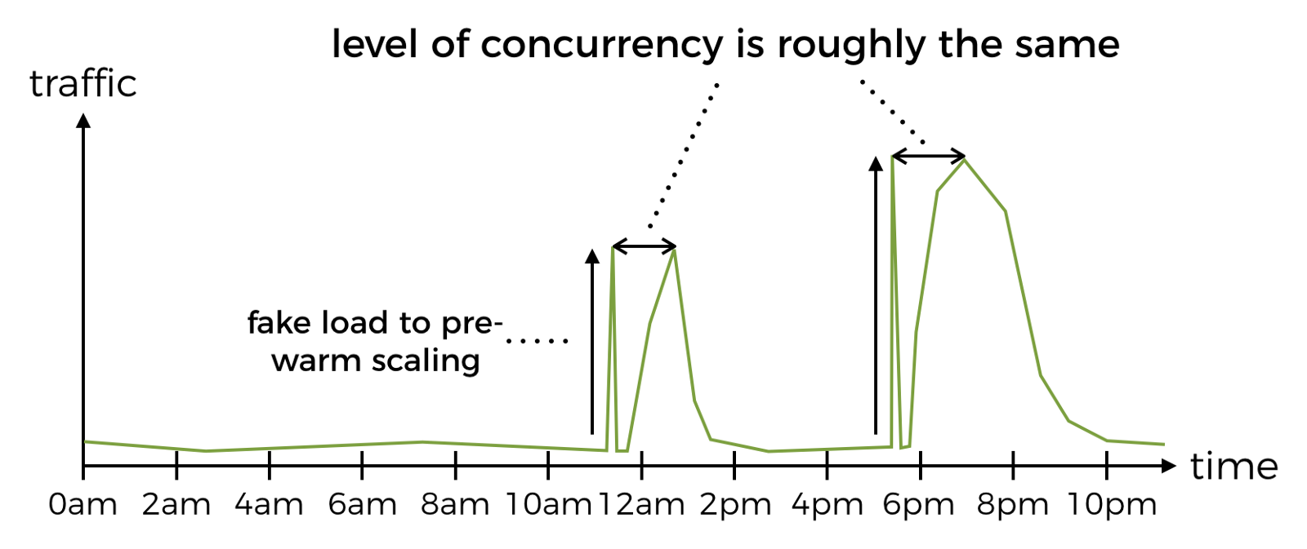
source: hackernoon.com/im-afraid-you-re-thinking-about-aws-lambda-cold-starts-all-wrong-7d907f278a4f
Notes:
Many people got into the habit of creating these Lambda warm-up mechanisms by simply pinging the lambda on a cron. Now although this sounds like a great idea, it will mean that only 1 instance is spun up. To spin up concurrent instances, you need to be sending parallel requests that forces AWS to spin up extra ones to deal with the load. In addition to this, Lambda’s are reset after 4 hours anyway, so you are going to get cold starts then. This is all to say, there are better ways of solving this problem.
But there are certain circumstances when you may want to keep lambda’s warm. Let’s for example consider Just Eat. They will have lots of orders coming in at around 12 noon and 5pm. If you have these regular occurrences then you could trigger a CloudWatch cron just before those times to fire requests at the lambdas and warm them to a sufficient degree. You could even attach a particular payload or header to these requests to make sure they avoid the primary code path and no cause bad data etc.
This sorta betrays the headline ethos of Serverless though - that you don’t need to worry about scaling.
But customer experience trumps all, and it’s important to have suitable response times because they could have a measurable financial impact. For example Akamai, a couple years ago found that for every 100 millisecond delay, website conversions were cut by around 7%. Reducing latency is key

Slide 41
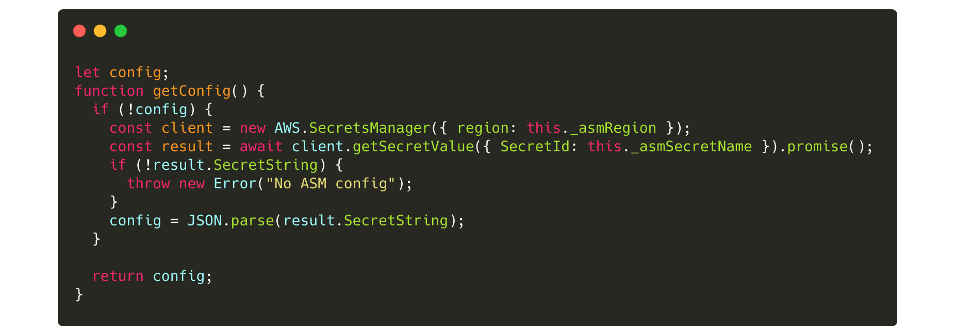
Caching
Notes:
Despite Lambda having a reputation as just a function service, it can do a whole lot more than that.
Let’s say on start your Lambda needs to go and fetch something from an API, like your configuration as in this code snippet.
You will only need to fetch this on cold start if you just save your config to a global or class variable. This way, on subsequent requests you will have already got the config.

Slide 42
Measure
Optimize
Monitor
Notes:
Now we’ve learnt how we can optimize our Lambdas, let’s look at how we can put this into practise.
We have 3 steps to this process

Slide 43
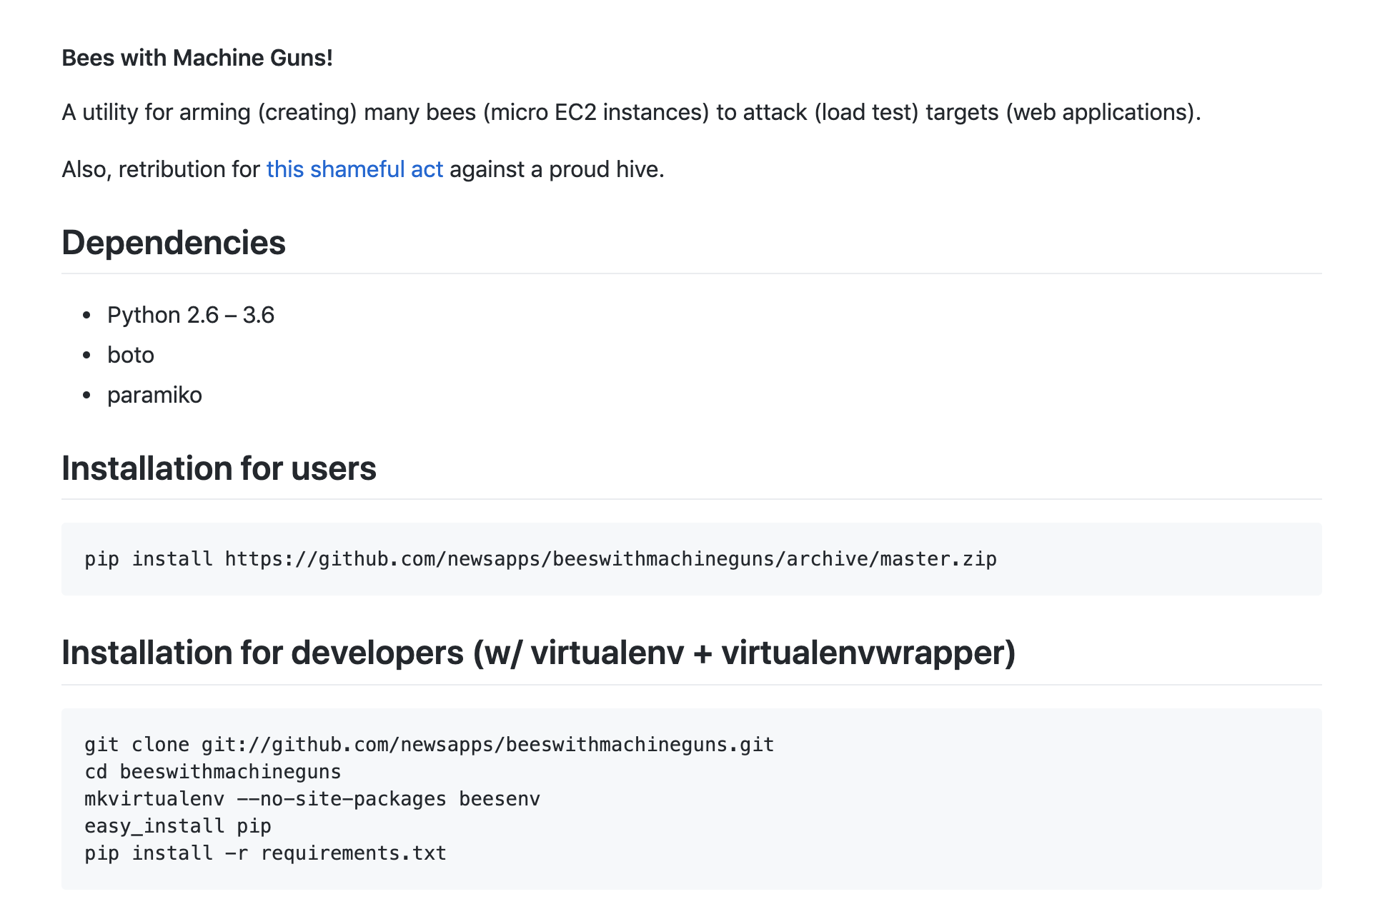
Measure - with bees!
Notes:
First, is to measure what the performance is currently. This will give you a good idea of what improvements you can expect.
We can use tools such as CloudWatch logs as I showed you before as well as AWS X-ray, Bees with machine guns and even local testing to benchmark where the app is currently
The important thing at this stage is not to do any improvements just find a way to measure any improvements we do make and also set realistic goals about what to expect after these improvements are made.

Slide 44
Optimize
Reduce start up dependencies
Scale Memory
Don’t use a VPC
Pool DB connections
Caching
Upgrade Runtime
NODE_ENV = production
Notes:
Ok, next step is to optimize, through the points we discussed in the talk and some we didn’t get time for like connection pooling and upgrading your runtime.

Slide 45

Monitor
Notes:
Now that all your optimizations are done, we need to see if they made any difference! How can we do this?
At a basic level, we can reuse CloudWatch and Dashbird which is analytics tool that is built on top of Cloudwatch.
However, to make things more advanced, you’re going to want to use tools such as...

Slide 46
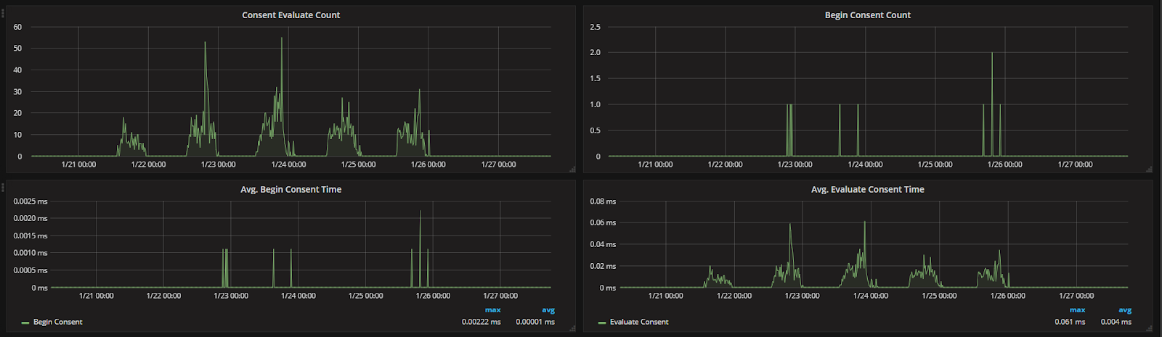
Grafana
https://blog.joshghent.com/using-grafana-for-monitoring-you-nodejs-apps-fac38c343907
Notes:
Graphite
Now graphite is a realtime monitoring tool that can be used for a variety of different metrics. It allows you to create cool graphs using Grafana like this…
It’s very simple to implement, at the top row we have “counts” which tracks the number of times a route is called.
The next row has a trace of the times the routes took to execute.
This is a very easy technology to deploy and implement so I’d recommend taking a look into it.
If you want help implementing it into Node specifically then take a look at my shamelessly self promote blog post on this topic.

Slide 47
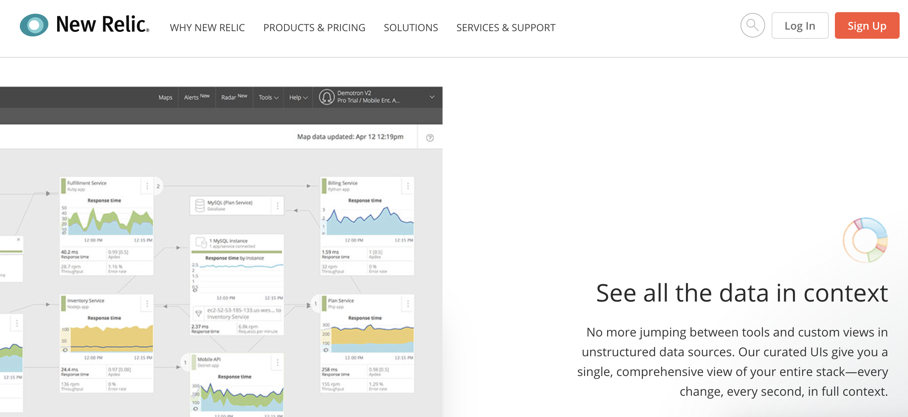
Notes:
King of the kings however is New Relic. New Relic is an APM which stands for application performance monitor. So it’s ideal for this kind of work.
Again, it’s dead simple to implement this and is basically a single line of code.
This will give you a lot of language specific insights into how the app is performing and even where you can make improvements

Slide 48
RECAP
Pro’s and Con’s of Serverless
When / When not to use Serverless
Optimizing Serverless Architecture
Billed only for what you use
Latency can suffer
Load balanced and maintained for you
File system and CPU allocations are limited
For breaking up monoliths
Don’t use it if you want to avoid heavy vendor lock in
Use for cutting costs and improving speed of deployments
Reduce startup dependencies
Scale Memory and CPU
Avoid VPC’s if you can
Implement caching
Remember MOM, measure, optimize, monitor
Notes:
So what have we learnt?
Well we’ve covered the pro’s and con’s of serverless
We’ve discussed when and when not to use serverless
We’ve found out how to convert to serverless or to write applications for serverless
And primarily we’ve learnt how to optimize them

Slide 49

</thank-you>
twitter
me@joshghent.com
website

